Slide 1
Quick Check
Does it matter which section goes first “.text”, or “.data” in source file?
What does the “int” command mean?
Each processor has a different machine language? T/F?
Each processor has it’s own assembly language. T/F?
No
Generates interrupt, number provided as byte value, eg. 0x80 (Linux system calls) http://www.ctyme.com/intr/int.htm
True
False – any machine can have more than one language

Slide 2
Assembly Language Lecture #3: Data Organization and Addressing Modes
Notes prepared for COMP 7615 (Carly Orr)
References and select slides from:
Computer Organization and Architecture (Stallings, 2016)
Structured Computer Organization (Tanenbaum, 2013)
http://www.nasm.us/doc/nasmdoc3.html (NASM Document)

Slide 3
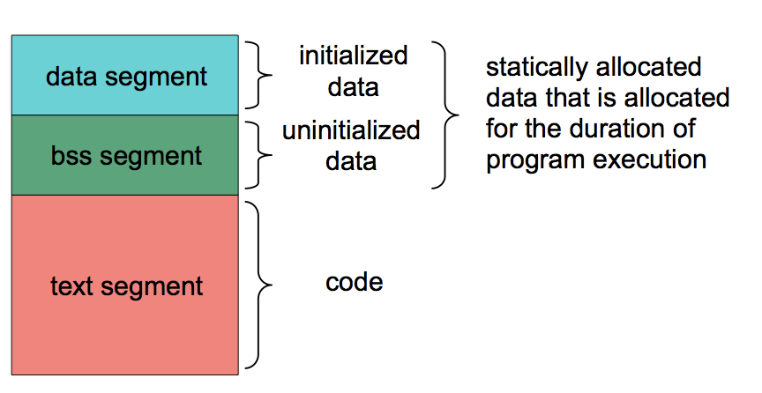
NASM program structure

Slide 4
Basic Elements – typing code
Character Set
Letters a..z A..Z ()
Digits 0..9
Special Chars ? _ @ $ . ~
NASM (unlike most assemblers) is case-sensitive with respect to labels and variables
It is not case-sensitive with respect to keywords, mnemonics, register names, directives, etc.

Slide 5
Basic Elements - Literals
Literals are values are known or calculated at assembly time
Examples:
'This is a string constant‘
"So is this“
`Backquoted strings can use escape chars\n`
1.20
FAAh
$1A010
x1A01

Slide 6
Basic Elements - Statements
Syntactic Form:
[label[:]] [mnemonic] [operands] [;comment]
(Note: [label] can also be [name])
Variable names are used in data definitions
Labels are used to identify locations in code
Note that ALL parts are optional => blank lines are legal
Statements are free form; they need not be formed into columns
Statement must be on a single line, max 128 chars
Example:
L100: add eax, edx ; add subtotal to running total
Labels often appear on a separate line for code clarity:
L100: add eax, edx ; add subtotal to running total

Slide 7
Basic Elements – types of statements
Assembler "statements" fall into three broad classes:
1. Directives
limit EQU 100 ; defines a symbol limit
%define limit 100 ; like C #define
2. Data Definitions
msg db 'Welcome to Assembler!'
db 0Dh, 0Ah
count dd 0
mydat dd 1,2,3,4,5
resd 100 ; reserves 400 bytes of uninitialized data
3. Instructions
mov eax, ebx
add ecx, 10

Slide 8
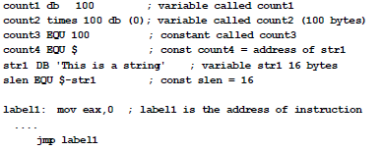
Basic Elements – variables, labels, constants
count1 is the address of a single byte,
count2 is the address of the first byte of 100 bytes of storage
count3 does not allocate storage; it is a textual EQUate (symbolic substitution; similar to C #define)
The $ has a special meaning: the location counter

Slide 9

Basic Elements – what is a variable anyway?
Variable names such as count1 and count2 represent addresses
Assembler associates with a variable is the location counter (current address)
Arrays are a fiction imposed by HLLs. They do not exist at the machine level.
The assembler sees no difference between count1 and count2 except for address

Slide 10

Basic Elements – location counter
The symbol $ refers to the location counter
The “output” of assembler is either ”code” or “data”
The location counter is incremented for each byte emitted
In the example above, count4 is numerically the same value as str1 (which is an address)
With slen EQU $-str1 the assembler performs the arithmetic to compute the length of str1
Note the use str1 in this expression as a numeric value (the address of the first byte)

Slide 11
Basic Elements - Integers
Integers: numeric digits (incl A-F) with no decimal point may include radix specifier at end:
b or y binary
d decimal
h hexadecimal
q octal
Examples
200 decimal (default)
200d decimal
200h hex
200q octal
10110111b binary
Note: Hexadecimal literals start with A-F must have a leading 0.
NASM also supports other syntactic forms, e.g., 0xc8 or $c8 http://www.nasm.us/doc/nasmdoc3.html#section-3.4.1

Slide 12
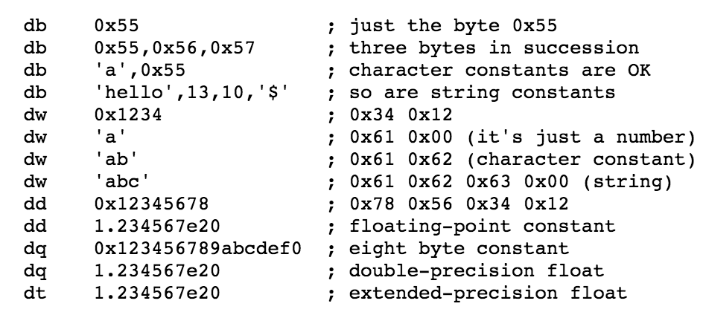
NASM: Initializing Data
EXERCISE:
How much “space” does each line take up in memory?
DB declare byte (8-bit)
DW declare word (16-bit)
DD declare double (32-bit)
DQ 64-bit floating point constant
DT 80-bit floating point constant
Note: Little endian

Slide 13
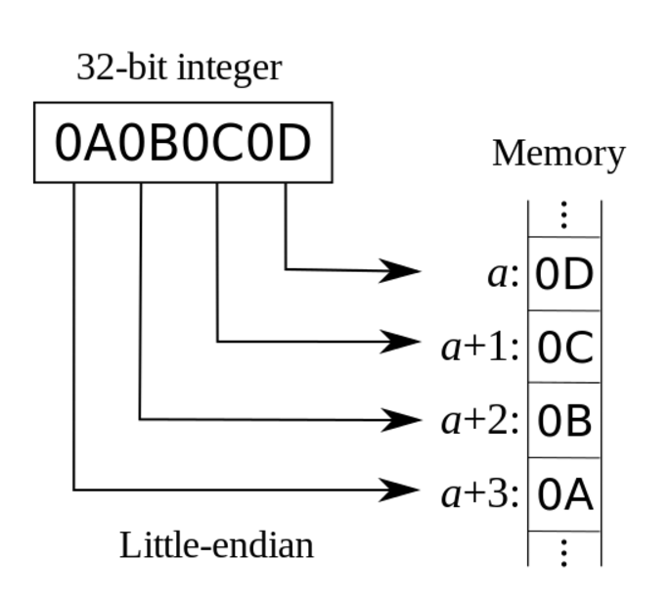
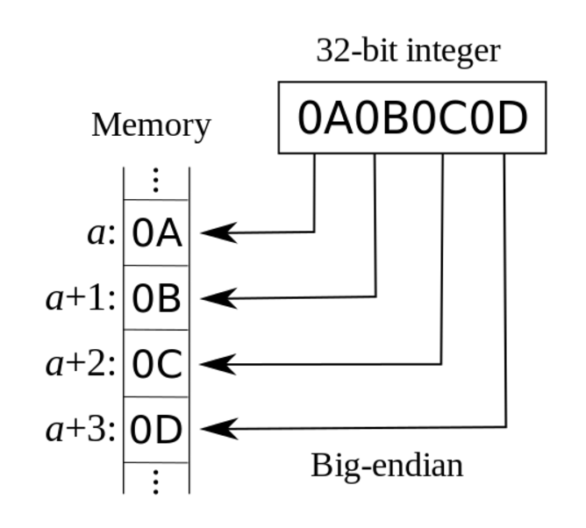
Endianness – ”how bytes inside a word are organized/stored in memory”
Little-endian
Big-endian
For fun, read Cohen (1980) http://www.ietf.org/rfc/ien/ien137.txt
Intel x-86 is ”little endian” (little end of the egg)

Slide 14
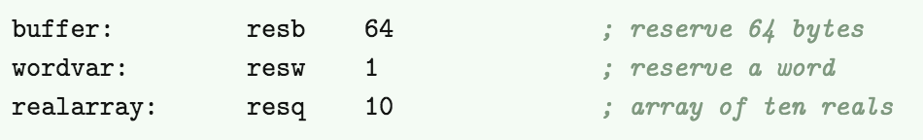
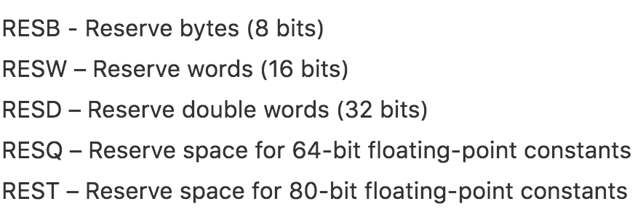
SECTIONS of a NASM program
SECTION .data (initialized data resides – seen already)
SECTION .text (where executable code resides - seen already)
SECTION .bss (uninitialized data resides)
Example of what goes in .bss SECTION:
Possible data types:

Slide 15
DEMO
DATA DECLARATION

Slide 16
Addressing Modes
Operations may have zero, one, two, or three operands.
Examples:
MOV destination, source ;two operands
NEG destination ;one operand
RET ;no operand
Operands may be specified in one of three basic forms:
Immediate - just a number (fastest)
Register - involves register (fast)
Memory - involves main-memory (slowest)

Slide 17
Overview: ADD X, Y (two operands) MOV A, B (two operands)
type
Register addressing | The register contains the data | MOV EAX, EBX ;copies what is in ebx into eax MOV ESI, VAR ;copies address of var into esi
Immediate addressing |  | MOV EBX, 20 ;source operand is immediate value of 20
Direct memory addressing | The register holds the address, which contains the data | MOV EAX, [1000H] ;move contents of 1000h to eax MOV ESI, [VAR] ;move contents of address var
Register Indirect addressing | The register holds a memory address, which contains the data | MOV EAX, [EBX] ;move contents of address stored in ebx

Slide 18
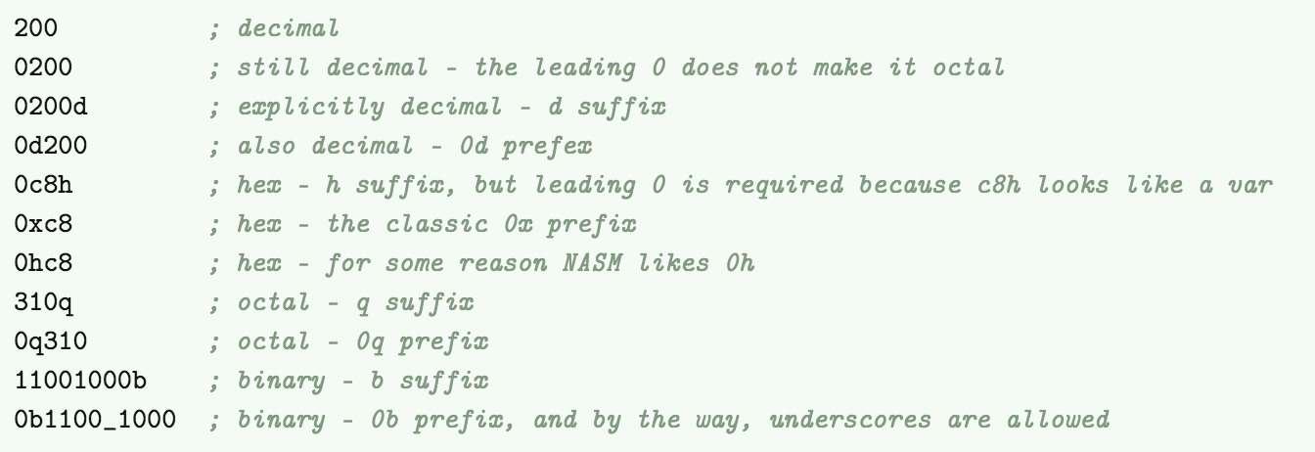
Immediate Addressing
Data has a constant value, or an expression.
Typically, first operand is register or memory location, and second operand is immediate.
First operand defines length of data.
Examples: ADD var, 65 ;an immediate operand 65 is added
MOV AX, 45h ;immediate constant 45h is transferred
Immediate data forms:

Slide 19
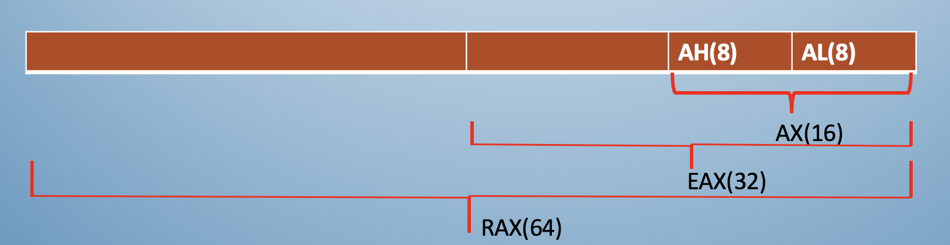
Register Addressing
The register provided contains the data.
May be the 1st, 2nd operand, or both.
Data is processed quickly, since no memory is involved.
Examples:
MOV DX, [tax_rate] ;register in first operand
MOV [COUNT], CX ;register in second operand
MOV EAX, EBX :both operands are in register

Slide 20
Direct Memory Addressing
Need to go to memory to get data.
Slower processing
Effective address is enclosed in square brackets
Optional offset with arithmetic
Example: a dd 3
b dd 5
mov eax, [a]
add eax, [b] ;OR add eax, [a+4]
Example: mov eax, [ebx*2+4]

Slide 21
Register Indirect Addressing
Register holds a memory location where data resides
Generally used for variables containing several elements (arrays)
Optional index with arithmetic
Example: table dd 1, 2, 3, 4, 5
mov esi, table
mov [esi], 110d
mov [esi+4], 123d
mov [esi+8], 456d ;same as mov [esi+4*2], 456d

Slide 22
Example MOV instruction: MOV destination, source
MOV register, register
MOV register, immediate
MOV memory, immediate
MOV register, memory
MOV memory, register
Five possible forms
Note: - both operands must be same size
- value of course operand remains unchanged

Slide 23
DEMO
Register Indirect and Memory Indirect

Slide 24
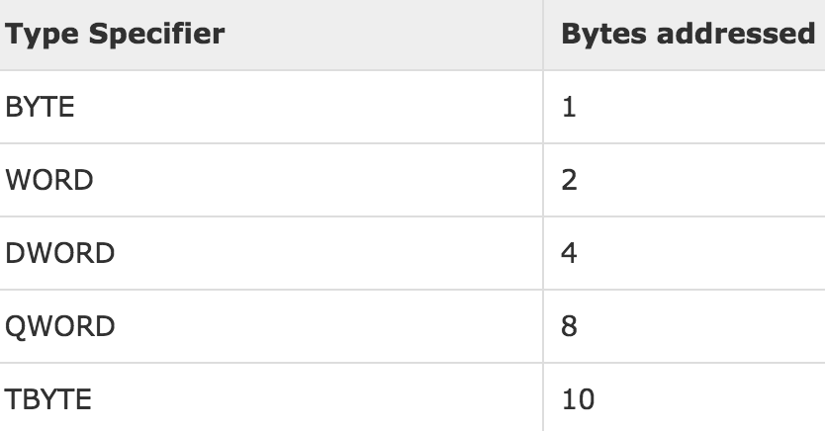
CAVEAT: specify data type
Some instructions like MOV can cause ambiguity.
MOV ESI, table
MOV [ESI], 110
Problem: If we are moving the decimal value 110 into memory, should it occupy a byte (8bit) or a word (16bit), or a double (32bit)?
Solution: use a type specifier
Eg. MOV DWORD [ESI], 110

Slide 25
Instruction size – varies (depends on addressing modes of operands!)

Slide 26
Test Your Understanding
Is NASM case sensitive?
What is the difference between MOV ax, foo versus MOV ax, [foo]?
How many bytes will this data declaration generate? (hint: “times” means allocate 10 words, each initialized to zero).
table times 10 dw 0

Slide 27
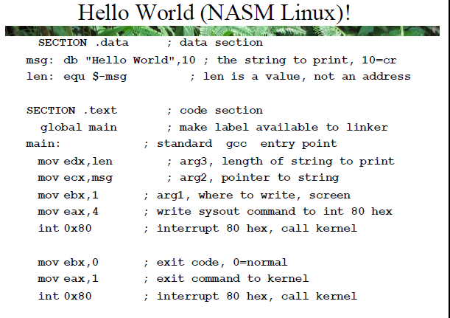

Slide 28
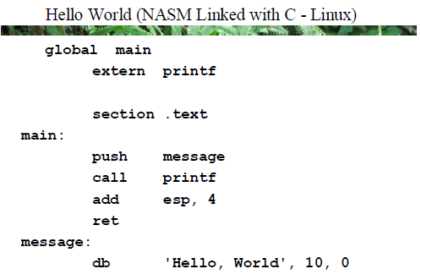

Slide 29
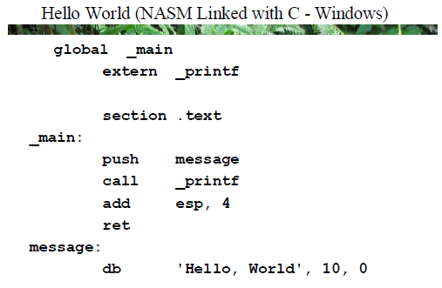

Slide 30
